Slide 1

Chapter 3
Traditional
Symmetric-Key Ciphers
3.<number>
Copyright © The McGraw-Hill Companies, Inc. Permission required for reproduction or display.

Slide 2
Chapter 3
Objectives
❏ To define the terms and the concepts of symmetric
key ciphers
❏ To emphasize the two categories of traditional
ciphers: substitution and transposition ciphers
❏ To describe the categories of cryptanalysis used to
break the symmetric ciphers
❏ To introduce the concepts of the stream ciphers and
block ciphers
❏ To discuss some very dominant ciphers used in the
past, such as the Enigma machine
3.<number>

Slide 3
3-1 INTRODUCTION
Figure 3.1 shows the general idea behind a symmetric-key cipher. The original message from Alice to Bob is called plaintext; the message that is sent through the channel is called the ciphertext. To create the ciphertext from the plaintext, Alice uses an encryption algorithm and a shared secret key. To create the plaintext from ciphertext, Bob uses a decryption algorithm and the same secret key.
Topics discussed in this section:
3.1.1 Kerckhoff’s Principle
3.1.2 Cryptanalysis
3.1.3 Categories of Traditional Ciphers
3.<number>

Slide 4
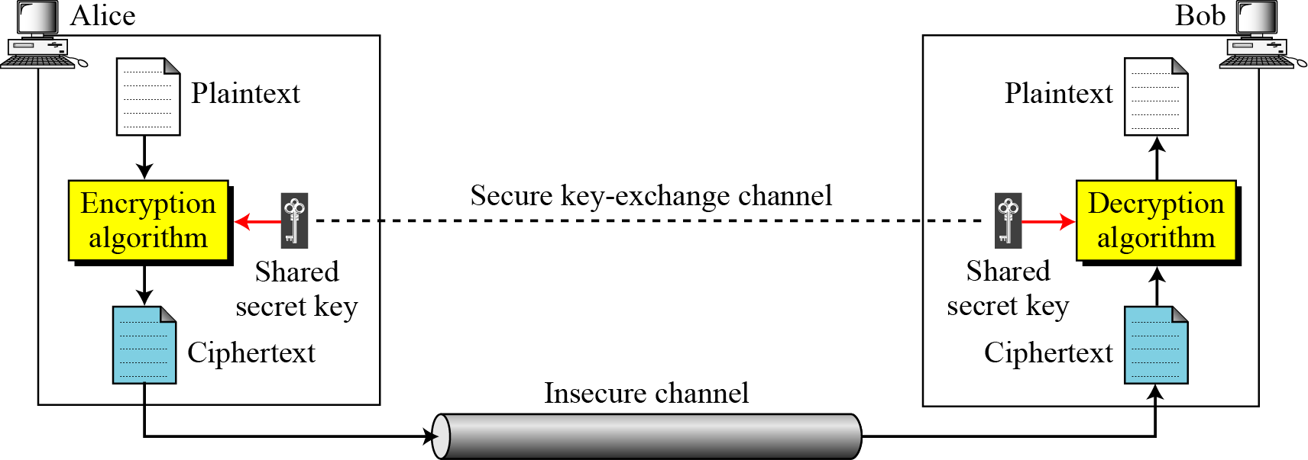
3.1 Continued
Figure 3.1 General idea of symmetric-key cipher
3.<number>

Slide 5
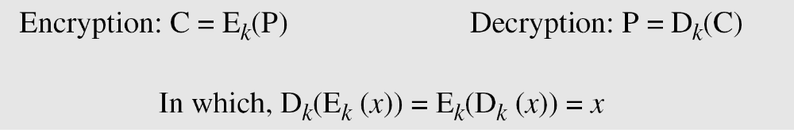
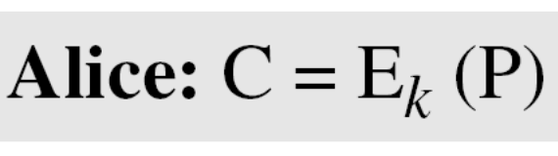
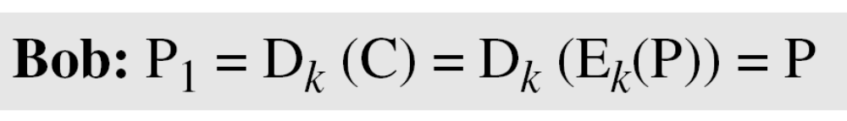
3.1 Continued
If P is the plaintext, C is the ciphertext, and K is the key,
We assume that Bob creates P₁; we prove that P₁ = P:
3.<number>

Slide 6
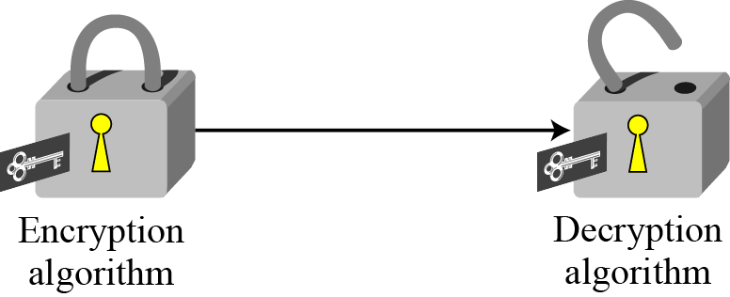
3.1 Continued
Figure 3.2 Locking and unlocking with the same key
3.<number>

Slide 7
3.1.1 Kerckhoff’s Principle
Based on Kerckhoff’s principle, one should always assume that the adversary, Eve, knows the encryption/decryption algorithm. The resistance of the cipher to attack must be based only on the secrecy of the key.
3.<number>

Slide 8

3-2 SUBSTITUTION CIPHERS
A substitution cipher replaces one symbol with another. Substitution ciphers can be categorized as either monoalphabetic ciphers or polyalphabetic ciphers.
Note
A substitution cipher replaces one symbol with another.
Topics discussed in this section:
3.2.1 Monoalphabetic Ciphres
3.2.2 Polyalphabetic Ciphers
3.<number>

Slide 9
3.2.1 Monoalphabetic Ciphers
Note
In monoalphabetic substitution, the relationship between a symbol in the plaintext to a symbol in the ciphertext is always one-to-one.
3.<number>

Slide 10
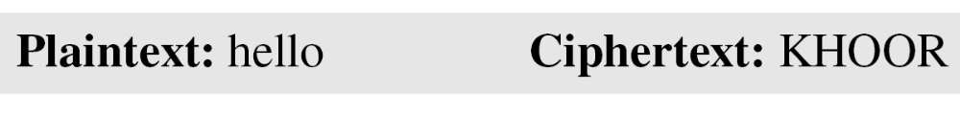
3.2.1 Continued
Example 3.1
The following shows a plaintext and its corresponding ciphertext. The cipher is probably monoalphabetic because both l’s (els) are encrypted as O’s.
Example 3.2
The following shows a plaintext and its corresponding ciphertext. The cipher is not monoalphabetic because each l (el) is encrypted by a different character.
3.<number>

Slide 11
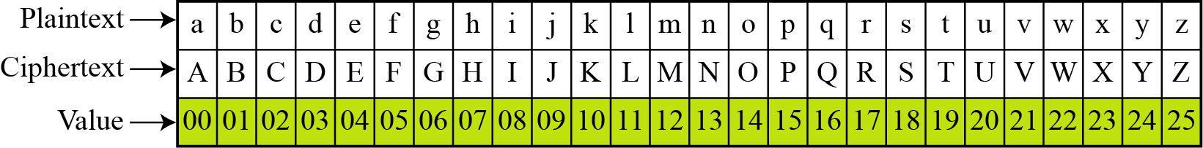
3.2.1 Continued
Additive Cipher
The simplest monoalphabetic cipher is the additive cipher. This cipher is sometimes called a shift cipher and sometimes a Caesar cipher, but the term additive cipher better reveals its mathematical nature.
Figure 3.8 Plaintext and ciphertext in Z₂₆
3.<number>

Slide 12
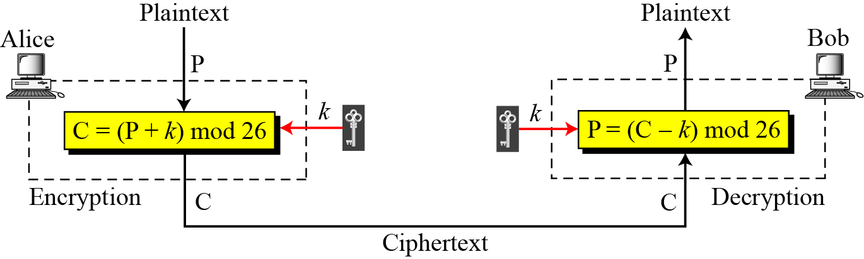
3.2.1 Continued
Figure 3.9 Additive cipher
Note
When the cipher is additive, the plaintext, ciphertext, and key are integers in Z₂₆.
3.<number>

Slide 13
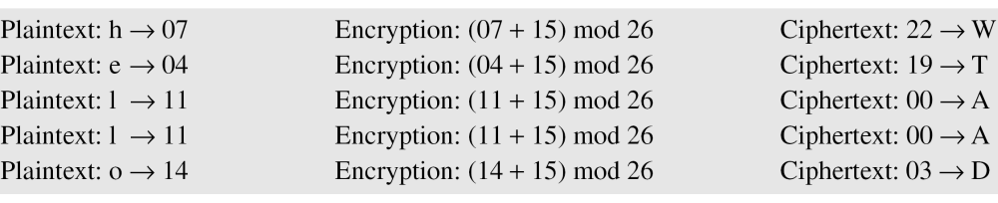
3.2.1 Continued
Example 3.3
Use the additive cipher with key = 15 to encrypt the message “hello”.
Solution
We apply the encryption algorithm to the plaintext, character by character:
3.<number>

Slide 14
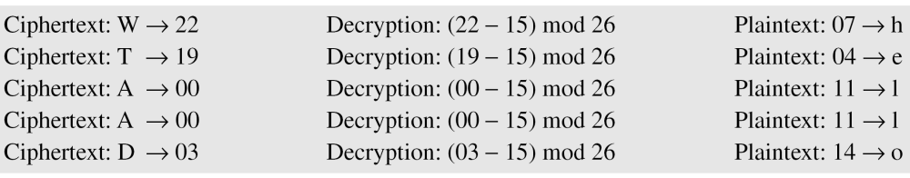
3.2.1 Continued
Example 3.4
Use the additive cipher with key = 15 to decrypt the message “WTAAD”.
Solution
We apply the decryption algorithm to the plaintext character by character:
3.<number>

Slide 15
3.2.1 Continued
Shift Cipher and Caesar Cipher
Historically, additive ciphers are called shift ciphers. Julius Caesar used an additive cipher to communicate with his officers. For this reason, additive ciphers are sometimes referred to as the Caesar cipher. Caesar used a key of 3 for his communications.
Note
Additive ciphers are sometimes referred to as shift ciphers or Caesar cipher.
3.<number>

Slide 16
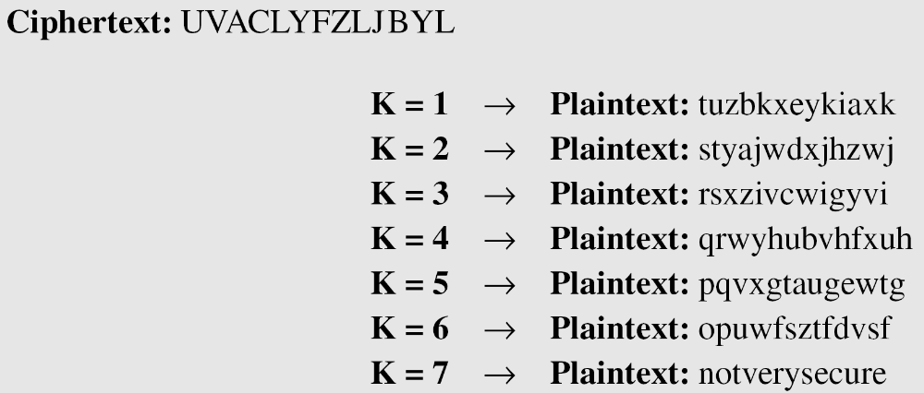
3.2.1 Continued
Example 3.5
Eve has intercepted the ciphertext “UVACLYFZLJBYL”. Show how she can use a brute-force attack to break the cipher.
Solution
Eve tries keys from 1 to 7. With a key of 7, the plaintext is “not very secure”, which makes sense.
3.<number>

Slide 17
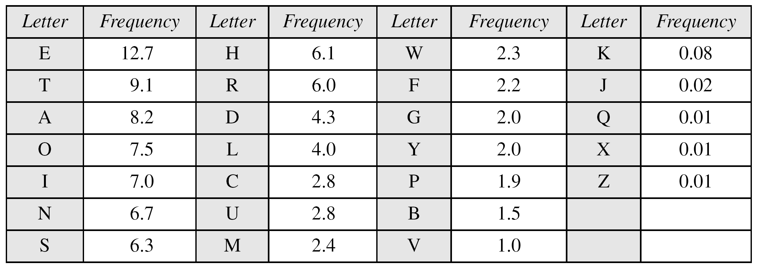
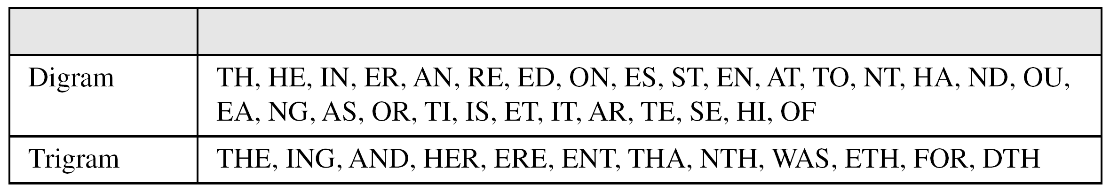
3.2.1 Continued
Table 3.1 Frequency of characters in English
Table 3.2 Frequency of diagrams and trigrams
3.<number>

Slide 18
3.2.1 Continued
Example 3.6
Eve has intercepted the following ciphertext. Using a statistical attack, find the plaintext.
Solution
When Eve tabulates the frequency of letters in this ciphertext, she gets: I =14, V =13, S =12, and so on. The most common character is I with 14 occurrences. This means key = 4.
3.<number>

Slide 19
3-3 TRANSPOSITION CIPHERS
A transposition cipher does not substitute one symbol for another, instead it changes the location of the symbols.
Note
A transposition cipher reorders symbols.
3.<number>

Slide 20
3.3.2 Keyed Transposition Ciphers
The keyless ciphers permute the characters by using writing plaintext in one way and reading it in another way The permutation is done on the whole plaintext to create the whole ciphertext. Another method is to divide the plaintext into groups of predetermined size, called blocks, and then use a key to permute the characters in each block separately.
3.<number>

Slide 21
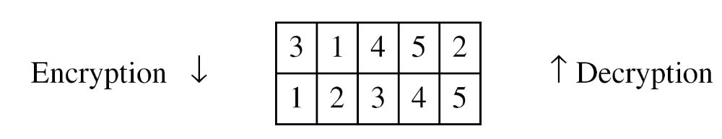
3.3.2 Continued
Example 3.25
Alice needs to send the message “Enemy attacks tonight” to Bob..
The key used for encryption and decryption is a permutation key, which shows how the character are permuted.
The permutation yields
3.<number>

Slide 22
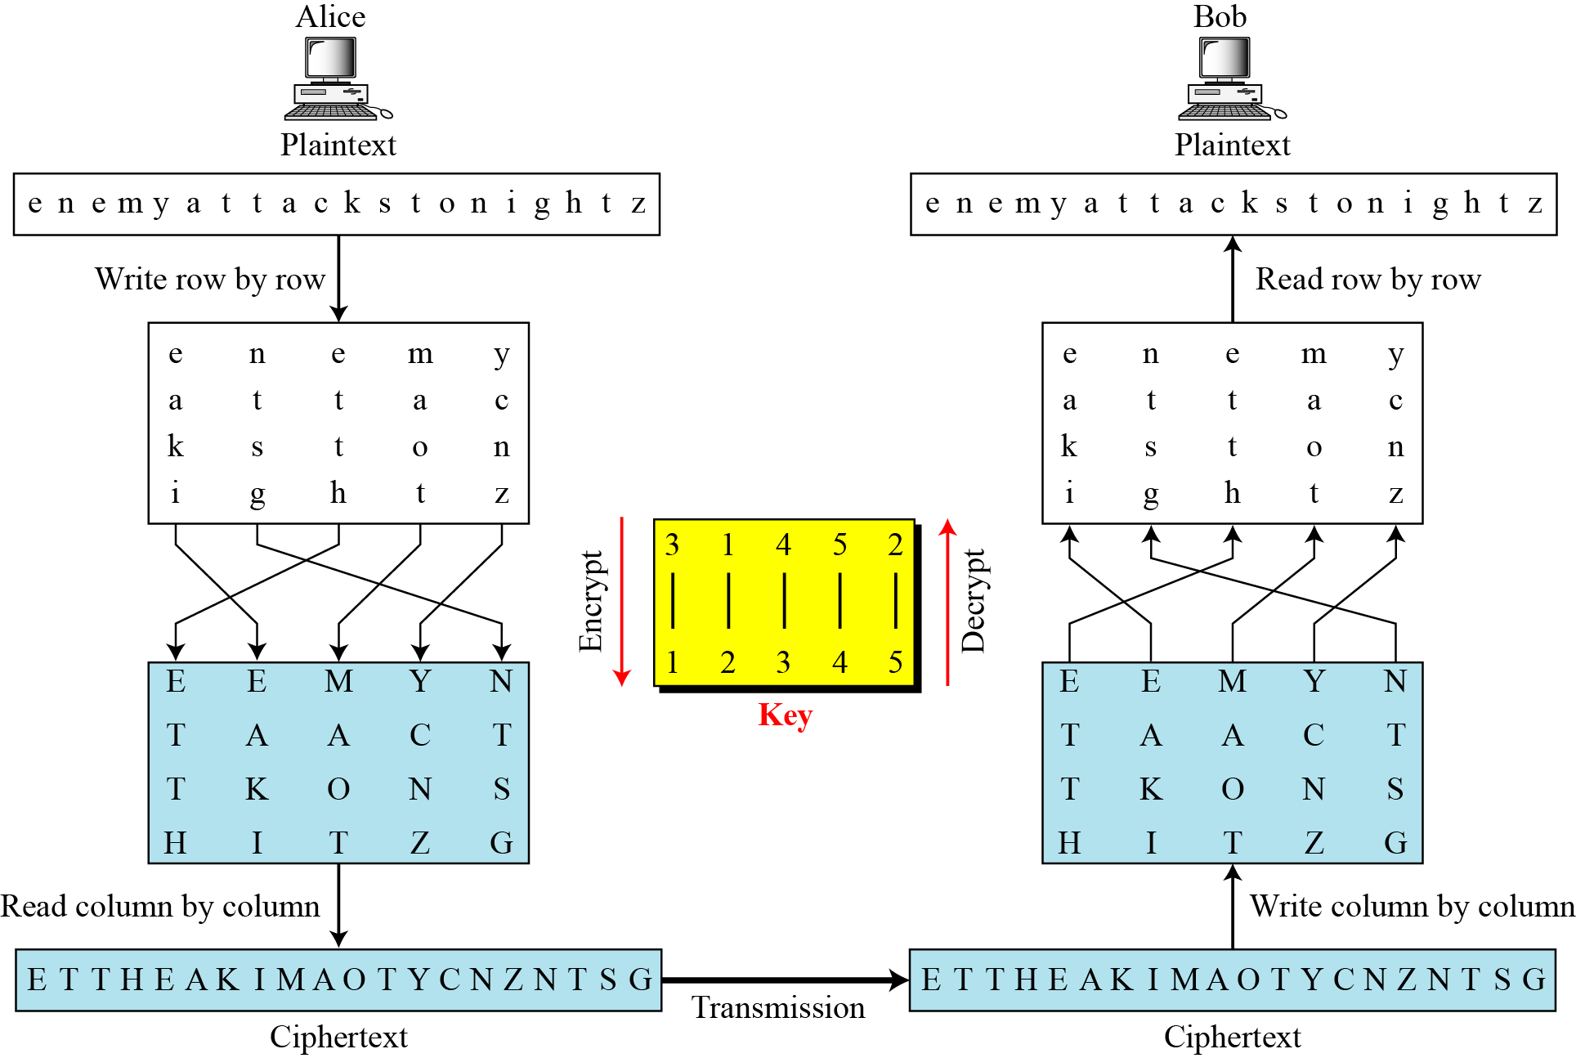
3.3.3 Combining Two Approaches
Example 3.26
Figure 3.21
3.<number>

Slide 23
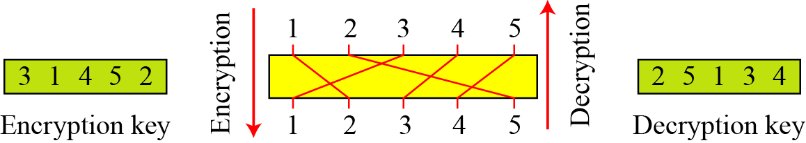
3.3.3 Continued
Keys
In Example 3.27, a single key was used in two directions for the column exchange: downward for encryption, upward for decryption. It is customary to create two keys.
Figure 3.22 Encryption/decryption keys in transpositional ciphers
3.<number>

